Slide 2
CVD of PdZn
Celia Cailloux , 7th of November

Slide 3
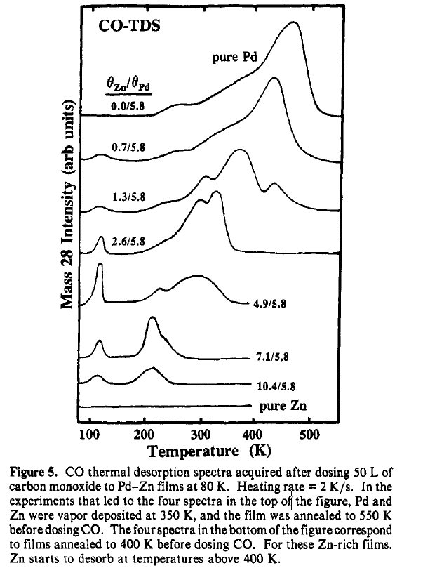
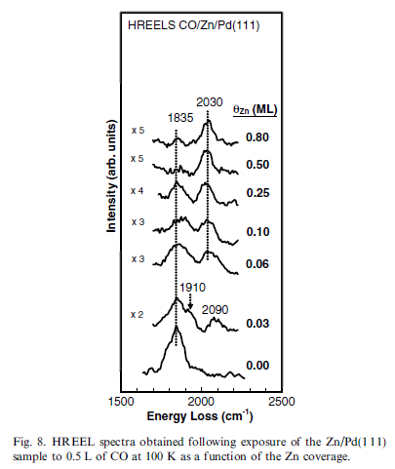
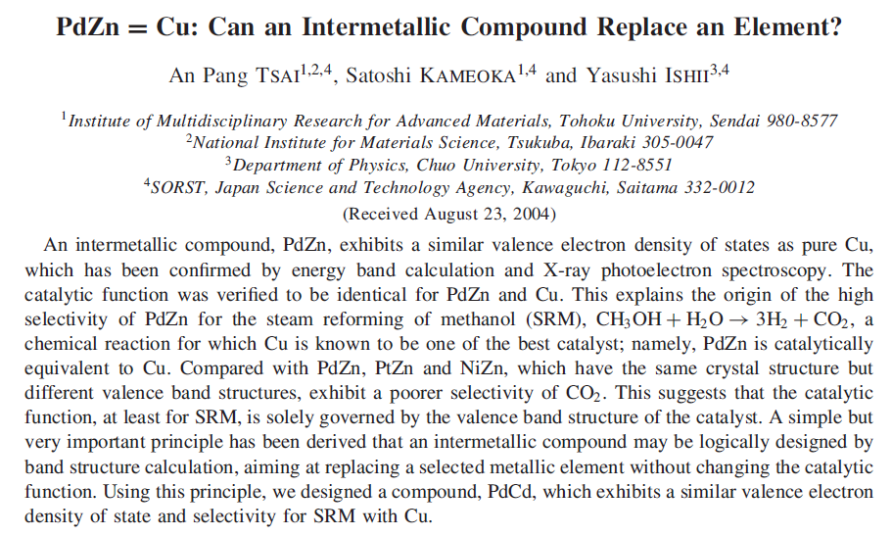
PdZn = Cu
Motivation for PdZn
PdZn forms a very stable intermetallic (~ -0.55 eV)
From PdZn form both geometric and electronic effects arise which gives a high degree of tunability with respect to its chemical properties, both activity and selectivity.
For steam reforming of methanol the electronic structure and catalytic effect of the PdZn intermetallic has been shown to resemble that of Cu
Adding Zn
Pd-CO
Zn-CO

Slide 4
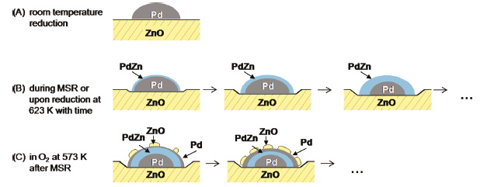
”Expected” (desirable) PdZn formation
PdZn
EXAFS on Pd/ZnO
At 623 K Zn starts to diffuse into the Pd nanoparticles and form PdZn
PdZn layer grows thicker over time
Preferential oxidation of Zn → ZnO segregation and formation of a Pd subshell
For MSR the PdZn is reversible
Föttinger, K. (2011). Dynamic structure of a working methanol steam reforming catalyst: In situ quick-EXAFS on Pd/ZnO nanoparticles. Journal of Physical Chemistry Letters, 2(5), 428–433

Slide 5
APVCD Procedure
Experimental
Cleaning
Cleaning of ceramics in Aqua Regia
Cleaned the quartz tube in 500 °C ~200 mL/min Ar for 1 h
CVD procedure
Placed the Pd film on top of the ceramic boat with a Zn shot underneath.
Flow Ar (~100 mL/min) for roughly 10 min
Pump down tube
Fill tube with Ar without a flow
Repeat 3 and 4
Reduction & annealing
Flow 100 mL/min 16 vol.% H₂/Ar and heat to desired annealing temperature for 1 h total
Flow 100 mL/min 16 vol.% H₂/Ar and heat to desired annealing temperature and leave reducing for 30 min. Then anneal for 1 h total with no flow. Then additional reduction for 30 min.
Cool down in 100 mL/min 16 vol.% H₂/Ar till reaching room temperature

Slide 6
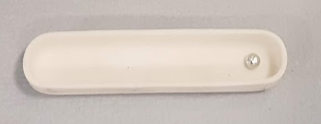
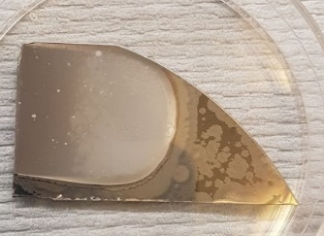
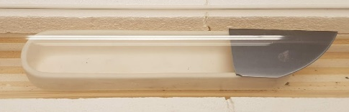
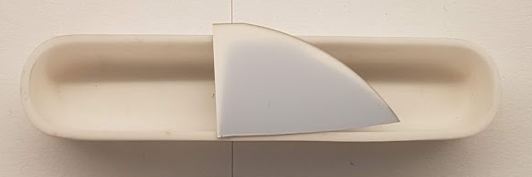
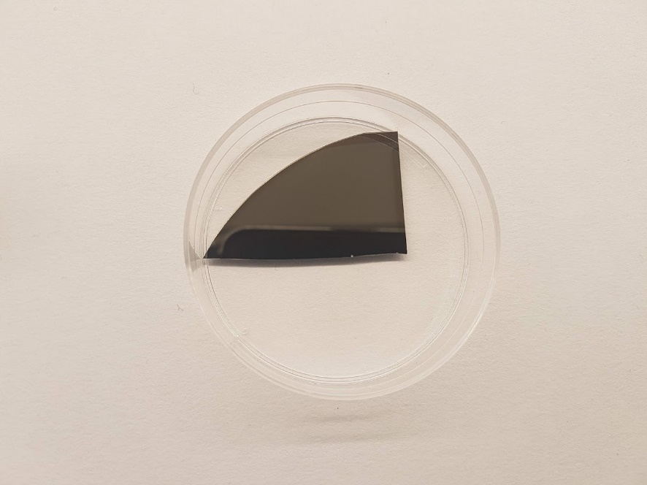
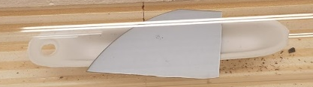
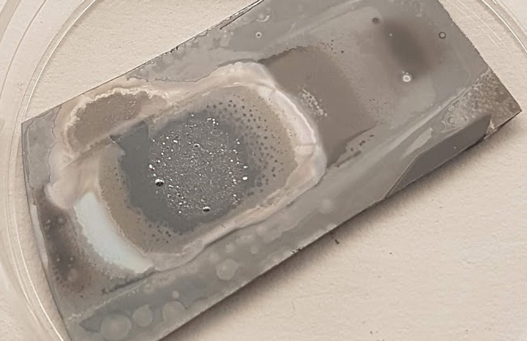
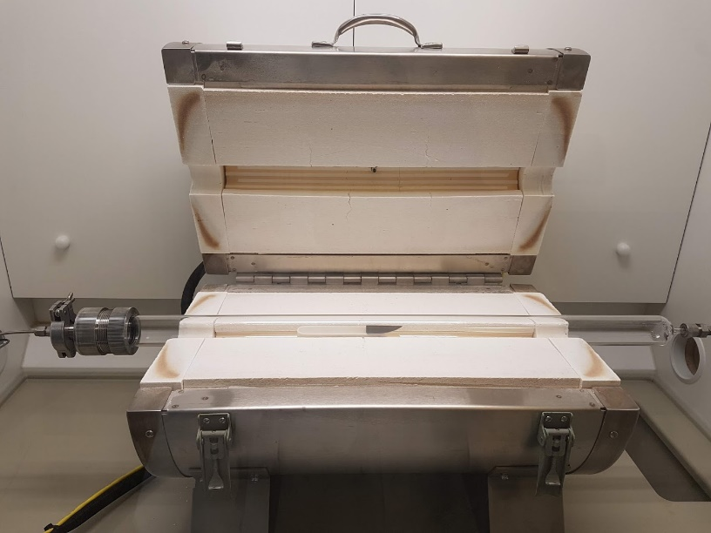
Configurations
Lateral gradient in Pd:Zn
Experimental
Three different configurations
Placing the Pd film at the end
Placing the Pd film in the middle
Changing to a smaller boat → shorter distance between Pd/Si and Zn pellet
A
Slow Zn deposition
B
C
Flow
Lateral gradient in Pd:Zn
Exhaust
Gas
Vacuum pump

Slide 7

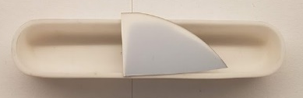
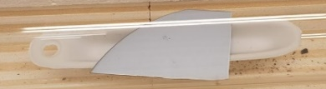
Samples
A
Experimental Procedure
Gas flow
100 ml/min
16/84 vol% H₂/Ar
B
C
Sample | Annealing temperature (° C /K) | Total time at annealing temperature (min) | Annealing time with no flow | Configu-ration
#1 | 600 (873) | 60 | - | A
#2 | 250 (523) | 60 | - | B
#3 | 350 (623) | 60 | - | B
#4 | 350 (623) | 120 | - | B
#5 | 350 (623) | 120 | 60 | C
#6 | 450 (723) | 120 | 60 | C
Flow

Slide 8
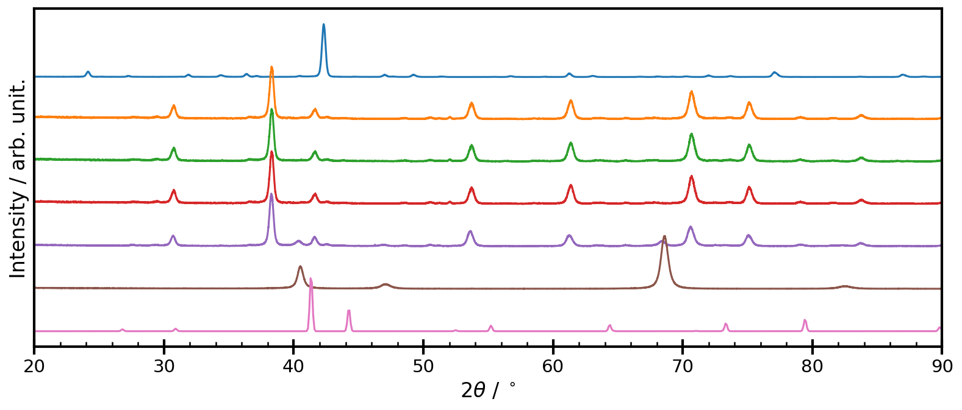
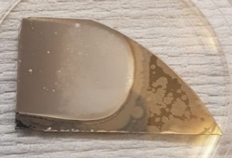





Annealing at different temperatures
GIXRD
ω = 0.5°
Mask = 10 mm

Slide 9
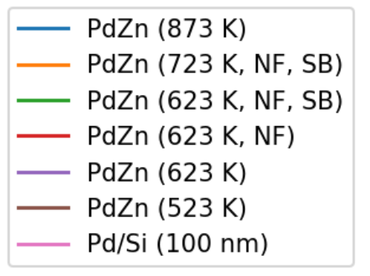
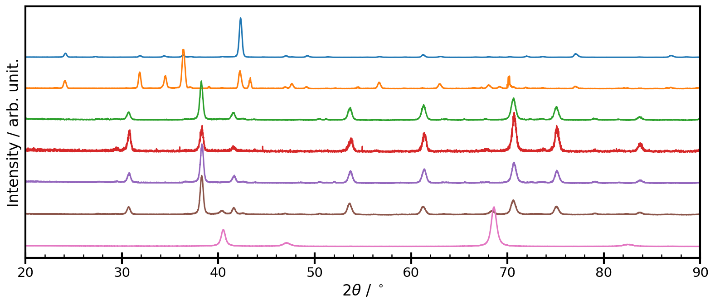

Annealing at different temperatures - Pd
GIXRD - ω = 0.5°, mask = 10 mm
No pure Pd at T > 523 K
873 K
723 K
623 K

Slide 10
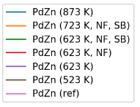
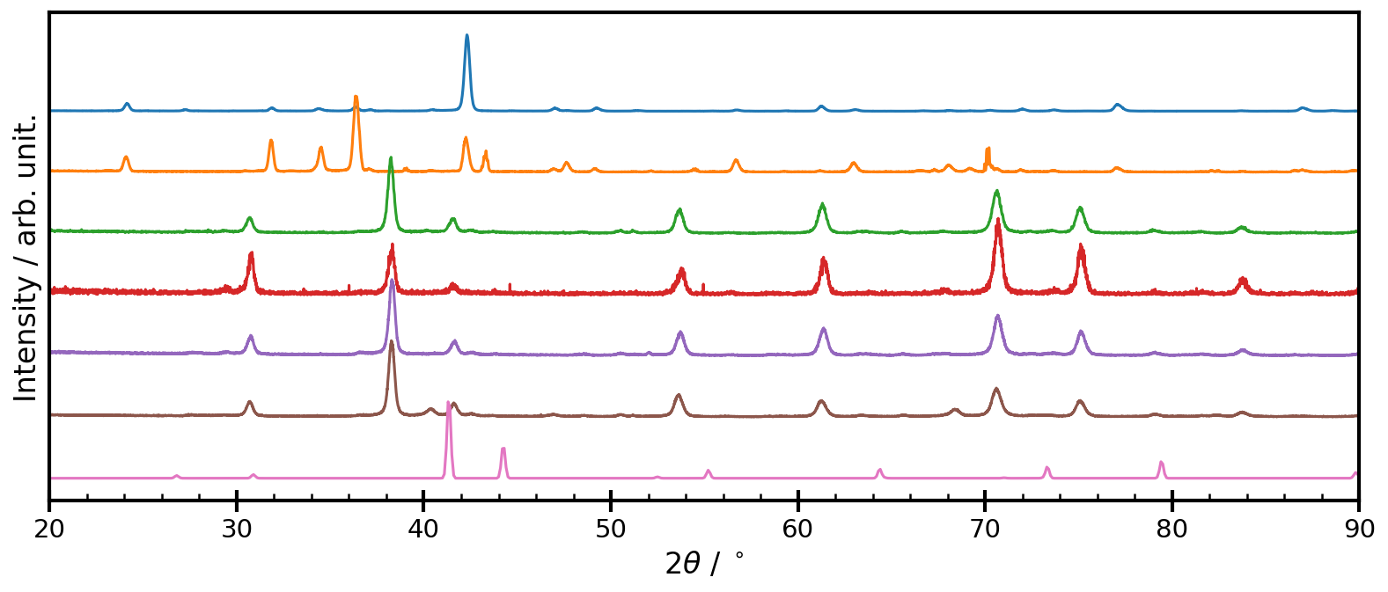
Annealing at different temperatures
GIXRD - ω = 0.5°, mask = 10 mm
No PdZn
873 K
723 K
623 K

Slide 11
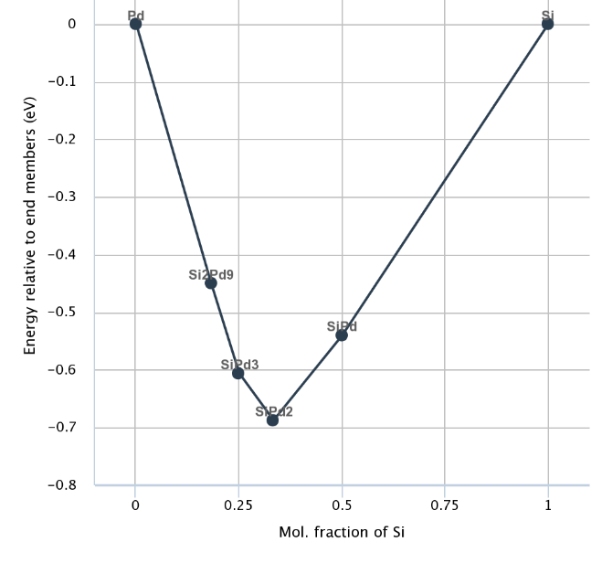
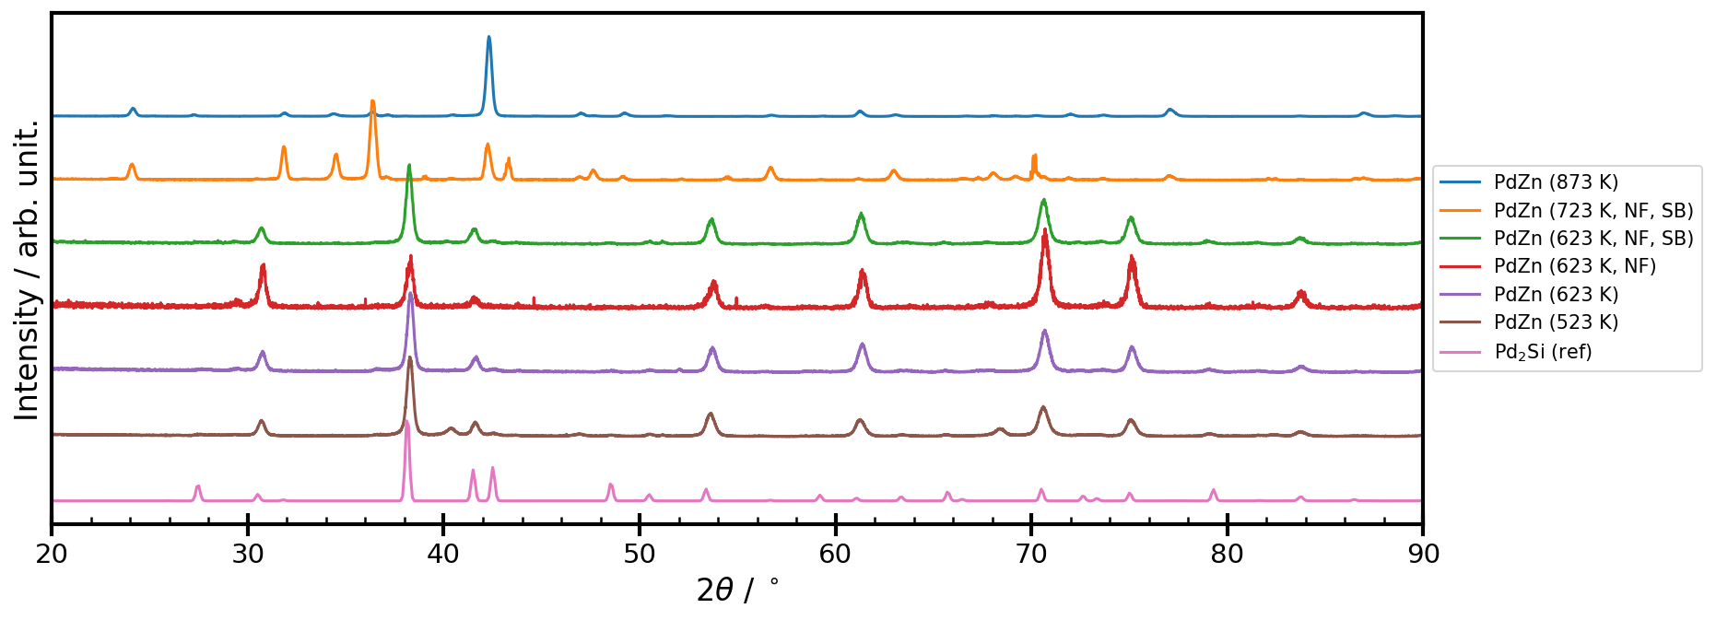
Annealing at different temperatures
GIXRD - ω = 0.5°, mask = 10 mm
Pd₂Si formation when Zn is no deposited
873 K
723 K
623 K

Slide 12
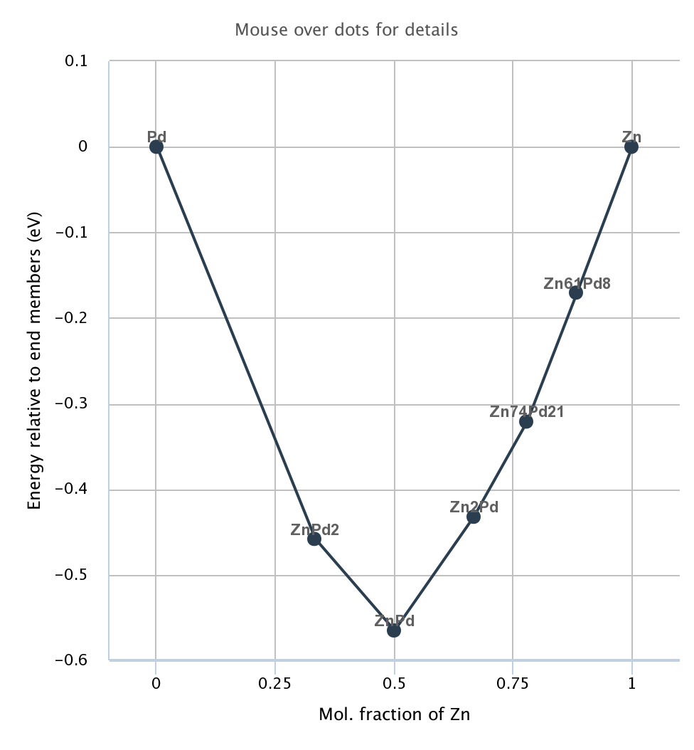
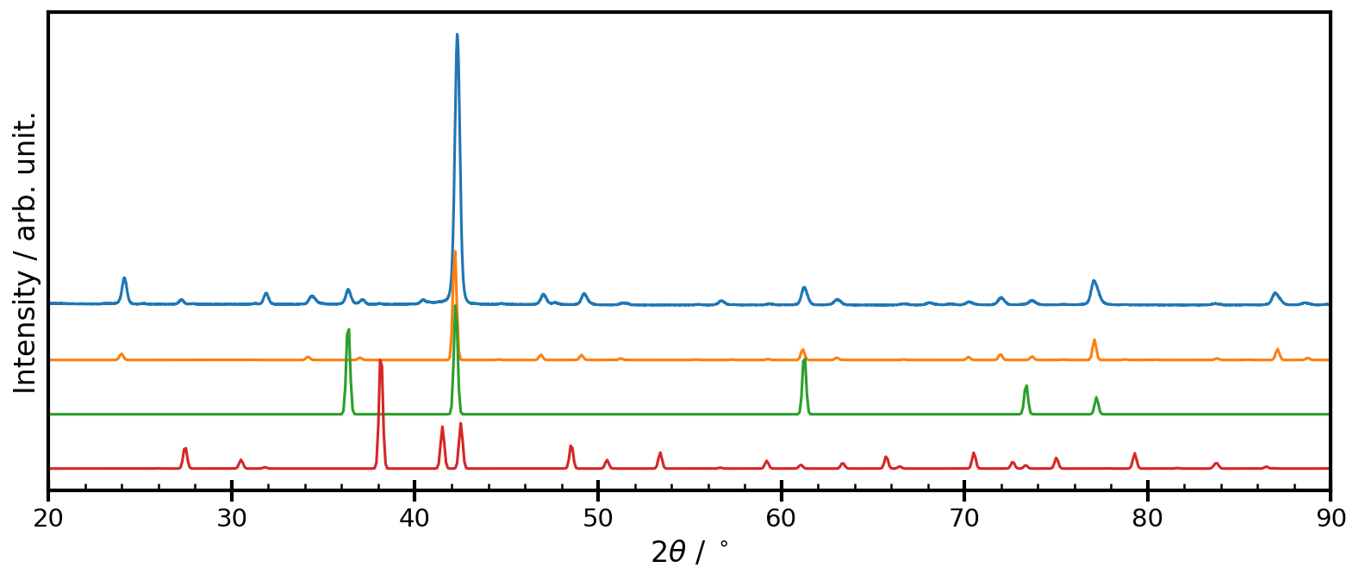
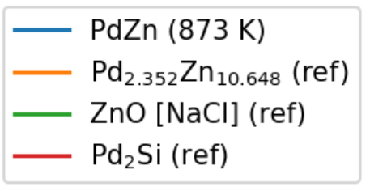
Annealing at 873 K → Pd_{2.352}Zn_{10.648}
GIXRD
Flow
Long distance
873 K

Slide 13
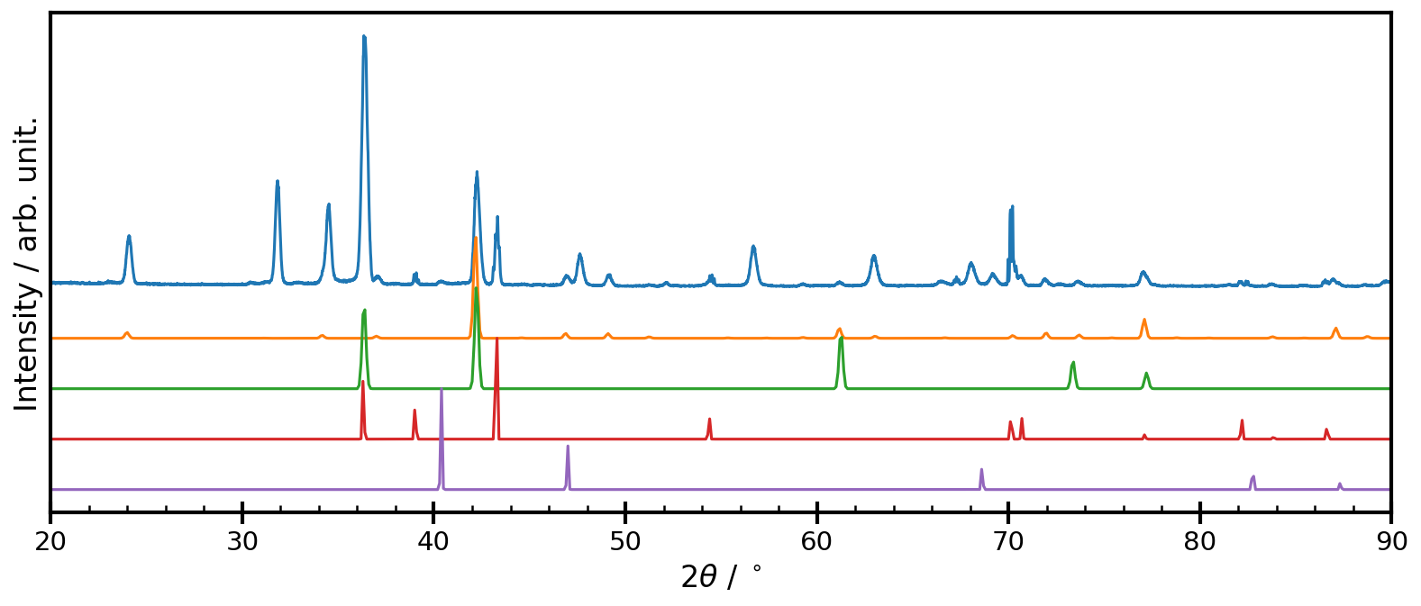
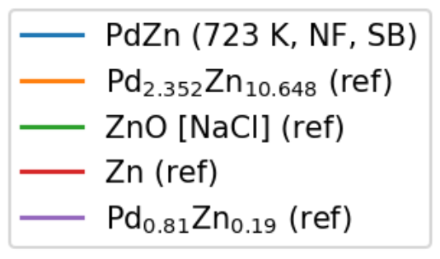
Annealing at 723 K → Pd_{2.352}Zn_{10.648}
GIXRD
No flow
Short distance
723 K

Slide 14
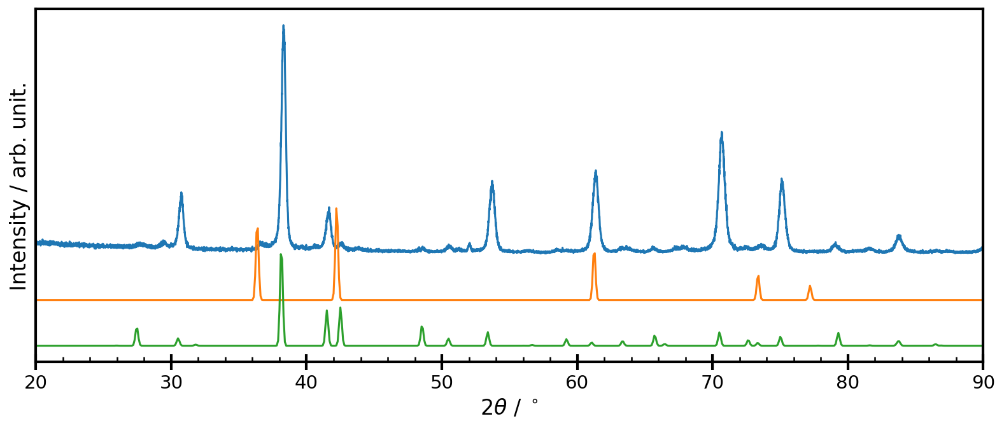
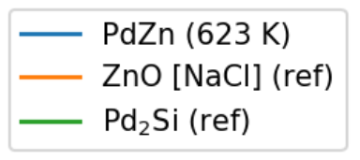
Annealing at 623 K → Pd₂Si
GIXRD
No flow/flow
Long/short distance
623 K

Slide 15
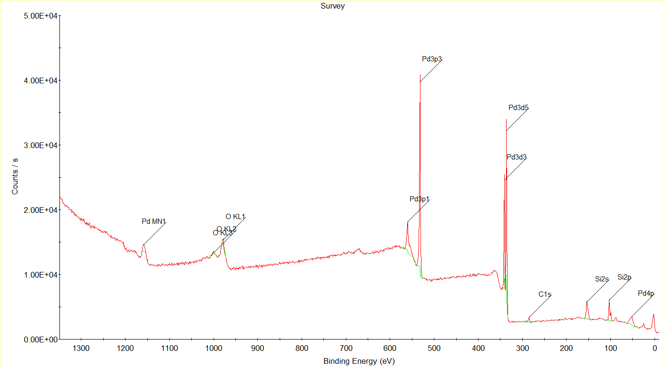
Annealing at 623 K → Si on the surface
XPS - survey

Slide 16
Next steps
CVD of PdZn
Synthesis
Use the large ceramic boat to avoid lateral gradients in the PdZn ratio
Find suitable annealing temperature(s)
Find correlation between temperature and PdZn ratio
Once Pd_{x}Zn_{y} is successfully synthesized
Investigate the thickness of the PdZn and there is a vertical gradient
Investigate zink oxide layer and Pd subshell formation over time
Deposition of alumina (Al₃O₂) and characterize surface

Slide 17
Any suggestions?
DO CVD at vaiours T for Pd to monitor the PdSi formation

